Slide 1
MAR 580: Advanced Population Modeling for Management of Living Marine Resources
Lecture 8
Simulation testing
www.mycourses.umassd.edu
03 November 2015

Slide 2
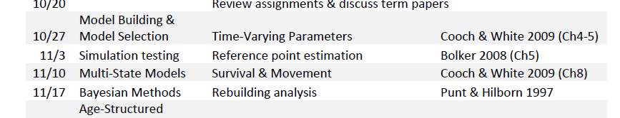
Today’s Outline
Simulations as part of modeling
Review of Bolker (2008) reading
Simulation testing to evaluate estimation performance
Lab exercise
Generating datasets, calling ADMB from R.
How well does our surplus production model estimate reference points?

Slide 3
Simulations
What is the role of simulations?
Simulation testing for statistics
Testing via Monte Carlo simulation is a key component of most operations research.
Roles for Simulation testing in fisheries science
Focus on using simulation testing to evaluate estimation performance
A related simulation approach, management strategy evaluation, will be dealt with in a few weeks time.

Slide 4
Simulations in fisheries science
Forecasting models using known parameters
e.g. project models from known starting points under different catch scenarios
introduce stochasticity to evaluate extinction risk
Variance estimation
Bootstrapping, Markov Chain Monte Carlo, etc.
Performance testing
Power analysis

Slide 5
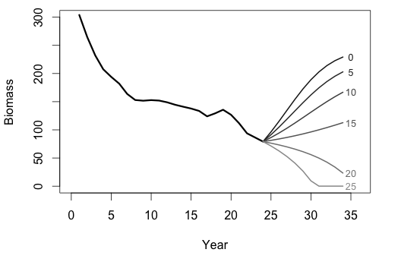
Forecasting given known parameters
e.g. biomass dynamics model under different levels of future catch

Slide 6
Variance estimation (also parameters too)
Sometimes it is not possible (or it is hard) to obtain analytic solutions for estimates of the variance (or our analytic solutions may be biased).
Simulations based on our statistical models can help us!
Bootstrapping (lots of different flavors)
Generate new datasets based on original data set or model fit (e.g. resample residuals)
Fit our model to new data sets
Do this lots of times to obtain distributions for parameter estimates.

Slide 7

Segue 1 : Residual Bootstrap
Purpose: generate estimates of uncertainty based on the assumptions of our statistical model (residuals normally distributed, homogenous variance, etc.)
Resample residuals (with replacement)
Add residuals to fitted values to obtain a new ‘bootstrapped’ data set
Re-fit the model to these data
Repeat.
Estimates are based on initial residuals, pulling ourselves up by our own bootstraps

Slide 8
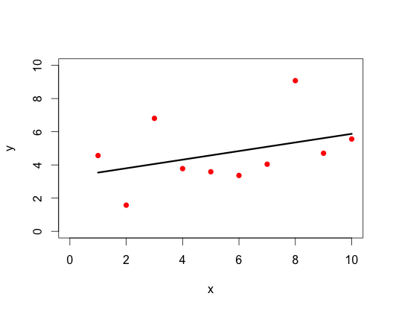
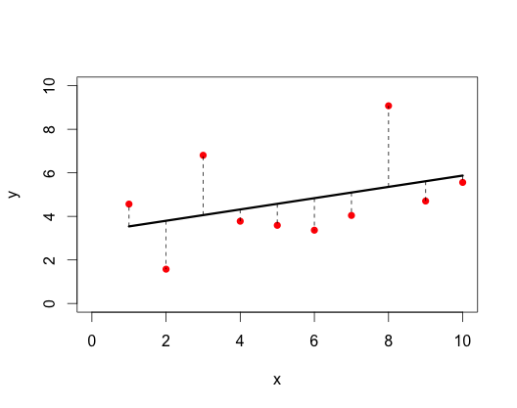
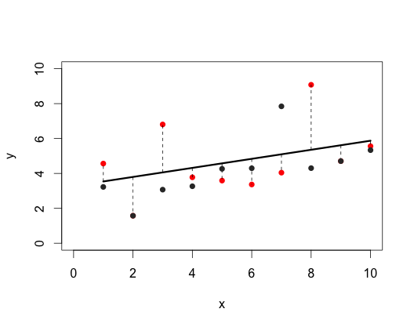
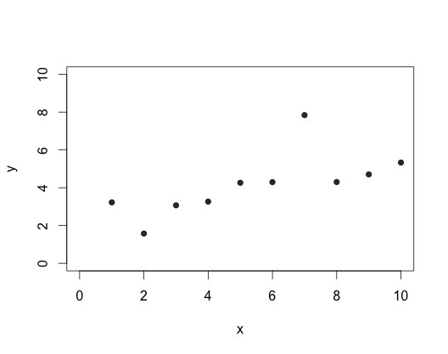
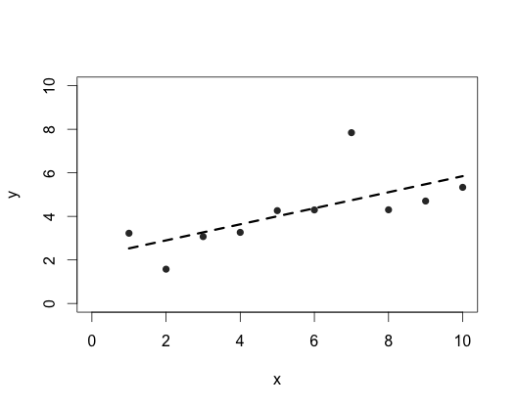
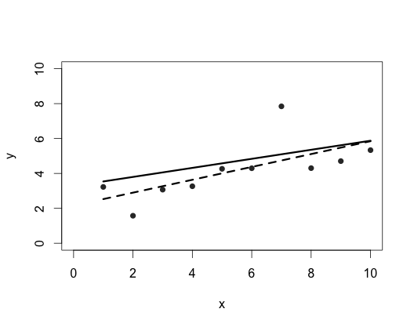
Resample residuals to obtain a new bootstrapped dataset, refit model

Slide 9
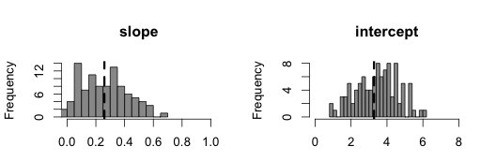
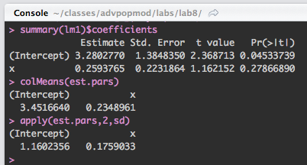
Perform n bootstraps, summarize estimates

Slide 10
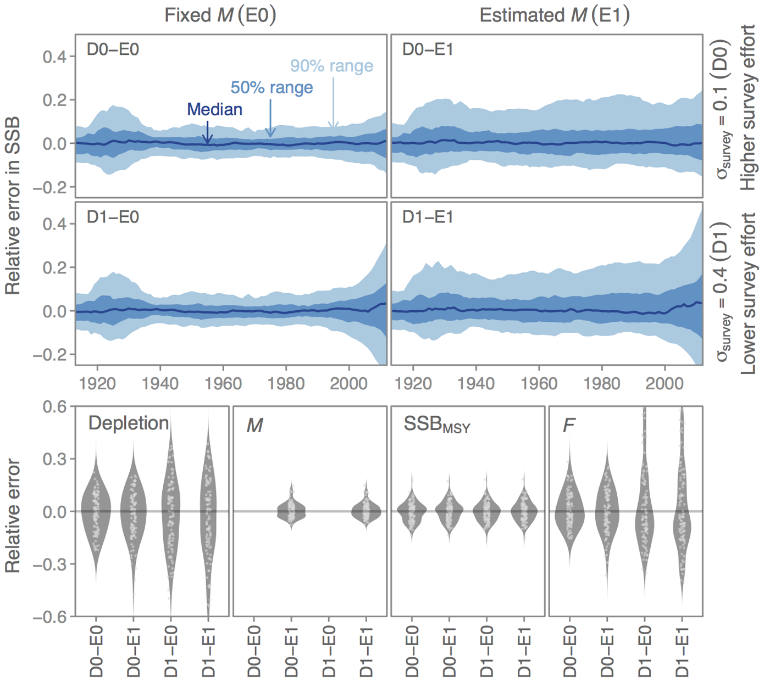
Testing Estimation performance
Anderson SC, Monnahan CC, Johnson KF, Ono K, Valero JL (2014) ss3sim: An R Package for Fisheries Stock Assessment Simulation with Stock Synthesis. PLoS ONE 9(4): e92725. doi:10.1371/journal.pone.0092725

Slide 11
How well do our models perform?
So far, we have fit models to data, and some times quantified the variance of our estimates of the parameters of those models.
This is known as estimation error, and is our model estimate of how well the procedure is doing.
However, our model estimates don’t relate to the true values, we have no way of knowing whether or not we got the right answer.
(we don’t know how many fish there are, so we don’t know if our estimate for current biomass is correct, or if our procedure is biased, etc.)

Slide 12
Simulation testing
We can use simulation testing to try to understand our model performance.
The general approach is to:
Develop a model for the system with known parameters (termed the operating model)
Generate a set of data from the operating model.
Fit our estimation procedure to the generated data set.
Compare the model estimates to the ‘true’ values that were used to generate the data.
Repeat steps 2 to 4 many times with different random realizations of the data set(s).
Calculate performance statistics based on how well the model estimates compare to the true values.

Slide 13
When might we want to take this approach?
Estimation performance of our model under ‘ideal’ conditions (if we had all the data in the world, can our model actually estimate its parameters?)
How does estimation change with different data scenarios?
Realistic data, data-poor situations, missing data, etc.
How does model mis-specification affect our estimates of quantities of interest?
e.g. What if recruitment is really driven by environment, but this isn’t accounted for in our assessment model? How does this affect our estimates of stock status / sustainable catch levels, etc.
Some models that perform well under ideal scenarios may be less robust when assumptions are not met.

Slide 14
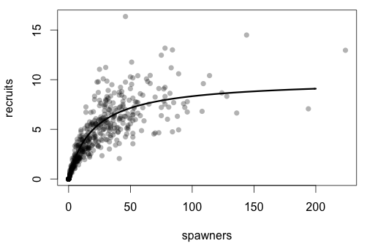
Example: stock recruitment relationship
Damselfish (Bolker 2008)
Recruits binomially distributed around Beverton-Holt given spawner data (from zero-inflated negative binomial).

Slide 15
Damselfish spawner-recruit
Test performance of functional forms for spawner-recruit relationship.
Shepherd stock recruit function:
(reduces to Beverton-Holt when d = 1)
Explore tradeoffs involved with adding complexity to models
What are the consequences of fitting a Beverton-Holt or Shepherd function to data generated from the above?

Slide 16
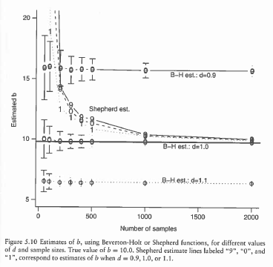
Damsels in distress with few data
Fitting a Beverton-Holt is biased when true dynamics are not B-H.
BUT… Shepherd estimate of d is biased at low sample sizes.
Also, variance of Shepherd estimate is much higher than variance of B-H estimate.
(Bolker 2008)

Slide 17
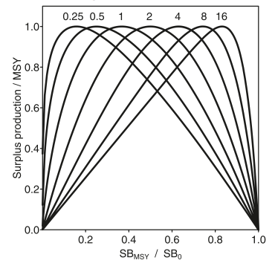
Example: Biomass dynamics
The Pella-Tomlinson model of surplus production is:
NB: This reduces to the Schaefer model when the shape parameter, z is equal to 2.

Slide 18
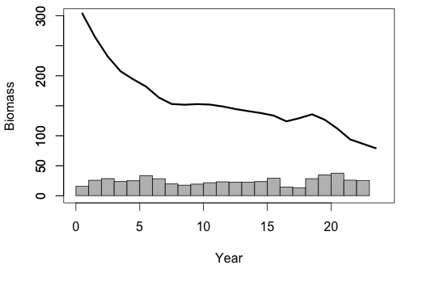
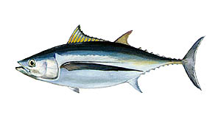
Lab 5 revisited – south Atlantic albacore
We fit the Schaefer model to the available data for years 1967-1989
How well can we expect this model to estimate the parameters and MSY based reference points?
r = 0.32
K = 245
B1/K = 1.24
q = 0.25
σ = 0.11

Slide 19
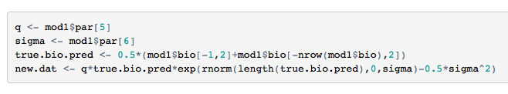
South Atlantic albacore – generating new data
Assume that true dynamics are governed by the estimated model parameters.
Our observation model is:
We generate new data sets based on the operating model biomass and values for q and sigma.

Slide 20
Segue 2: log-normal bias correction
Why do we do this?
The expected value for a random variable X that has a log-normal distribution is:
In our case we would like the mean of I_{t} to equal our model prediction.
We subtract σ²/2 to make the mean of the random variable equal to the median of the log-normal (which is its geometric mean).

Slide 21
Re-fitting our model with the new data
Our assessment model is an ADMB program.
But we just generated new data in R!
Steps:
First we have to create a data file containing the new CPUE data we generated.
Then we have to run our assessment model using this new data file.

Slide 22
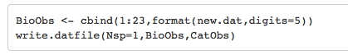
Re-fitting our model with the new data
Our assessment model is an ADMB program.
But we just generated new data in R!
Steps:
First we have to create a data file containing the new CPUE data we generated.
write.datfile() In lab8_functions.r takes a vector of catches and a table of cpue observations and writes a new datafile, “new.dat”, in the working directory.

Slide 23
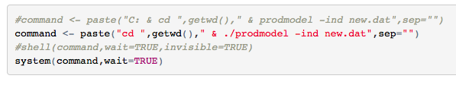
Re-fitting our model with the new data
Our assessment model is an ADMB program.
But we just generated new data in R!
Steps:
First we have to create a data file containing the new CPUE data we generated.
Then we have to run our assessment model using this new data file.

Slide 24
Segue 3: calling programs from R
One way to run a program from R is to use the system() function to invoke a OS command.
In Windows, system does not use a shell and there is a separate shell()
e.g. shell(command,wait=TRUE)
where ‘command’ can be the call to your ADMB program. Note that you are opening a shell, so you will need to include in the command instructions to change to the right directory.

Slide 25
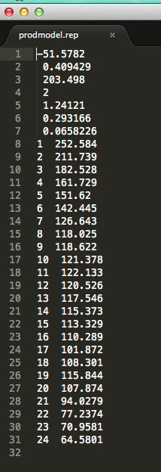
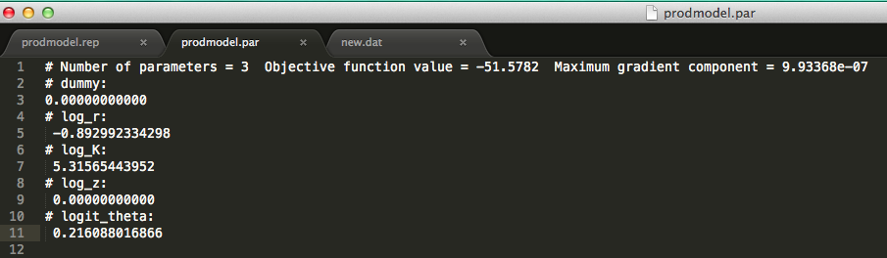
We have now fit our model to the new data
Hurrah!
Now we are interested in the results.
We also want to check if the model converged.

Slide 26
Next Steps
We fit the model to one simulated data set.
We need to do this MANY times.
We also need to store the results for each simulation.
The steps for each simulation are:
Generate a set of data from the operating model.
Write a new datafile containing the generated data set.
Fit the estimation model to the generated data set.
Store the parameter estimates from the simulation.
GOTO step 1.
Finally, we compare the estimates with the true values.

Slide 27
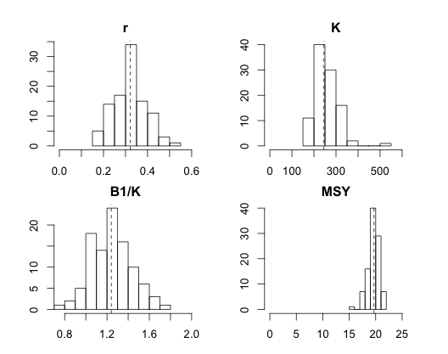
Estimation performance

Slide 28
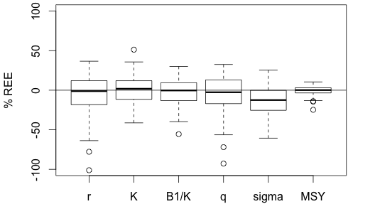
% Relative Error of Estimate (REE)
(Estimate-True)/True
Our model is biased in estimating σ
MSY is estimated precisely

Slide 29
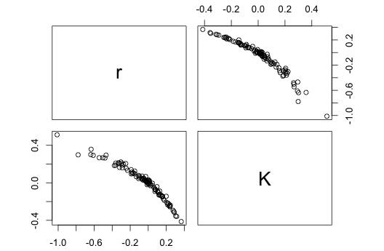
Correlations in errors
Not surprisingly, our errors in estimating r & K are correlated.

Slide 30
Other metrics of performance
We can also summarize errors in estimates for the predicted biomass and forecast quantities, say the catch next year under a FMSY strategy.
We are often interested in comparing results of two or more sets of simulations quantitatively, rather than just visually.
You will see many metrics in the literature, some focused on bias, others on precision, or both.
I like: Median Absolute Relative Error (MARE)
Using relative errors doesn’t always make sense. (e.g. if true parameter value is close to zero)

Slide 31
Thoughts on simulations
These days, simulation studies are almost de rigeur in the literature when developing new methods.
Simulation testing offers a powerful approach to explore the behavior of models under different scenarios.
They cannot tell us which models are the right ones to use, but are very useful in understanding the implications of our assumptions for model behavior, and can indicate robustness (or lack thereof)
Simulation testing exercises are experiments, and should be planned accordingly.
What sets of treatments (scenarios) do I need to answer the questions I am interested in?

Slide 32
Lab exercise
Simulation test performance of Schaefer biomass dynamics model to estimate stock status and reference points
Explore implications of model mis-specification for estimation of MSY based reference points.

Slide 33
What’s Next?
Multi-state models (11/10)
Reading: Cooch & White (2009) Chapter 8

